Slide 1
IndabaX Rwnada CNN overview
Mustafa Alghali

Slide 2
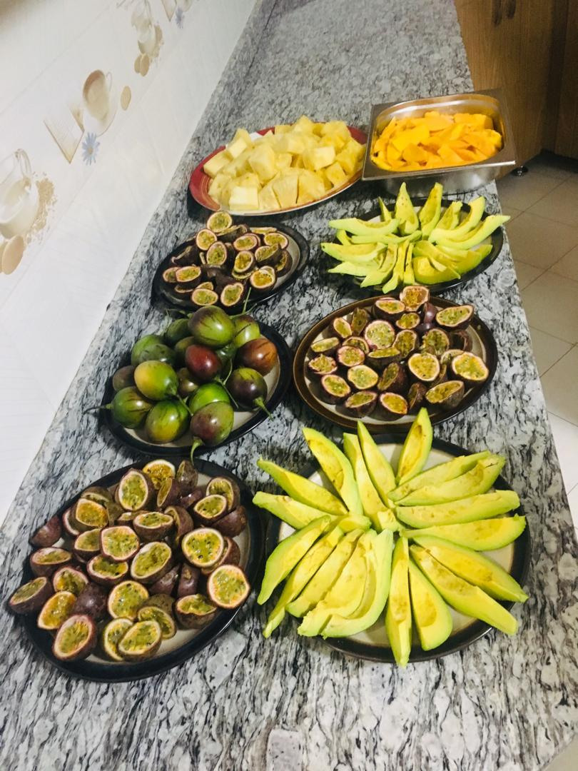
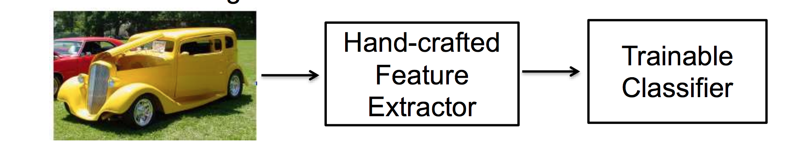
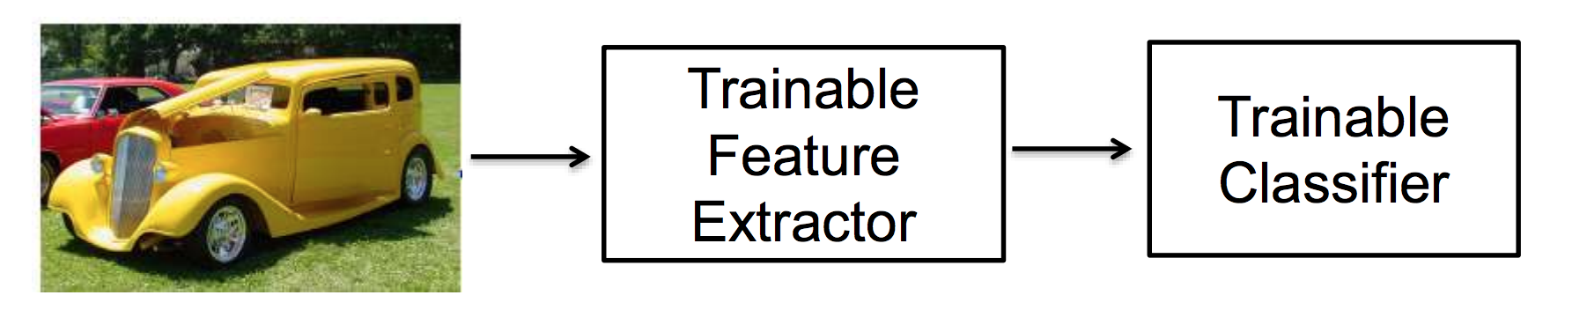
Traditional pattern recognition

Slide 3
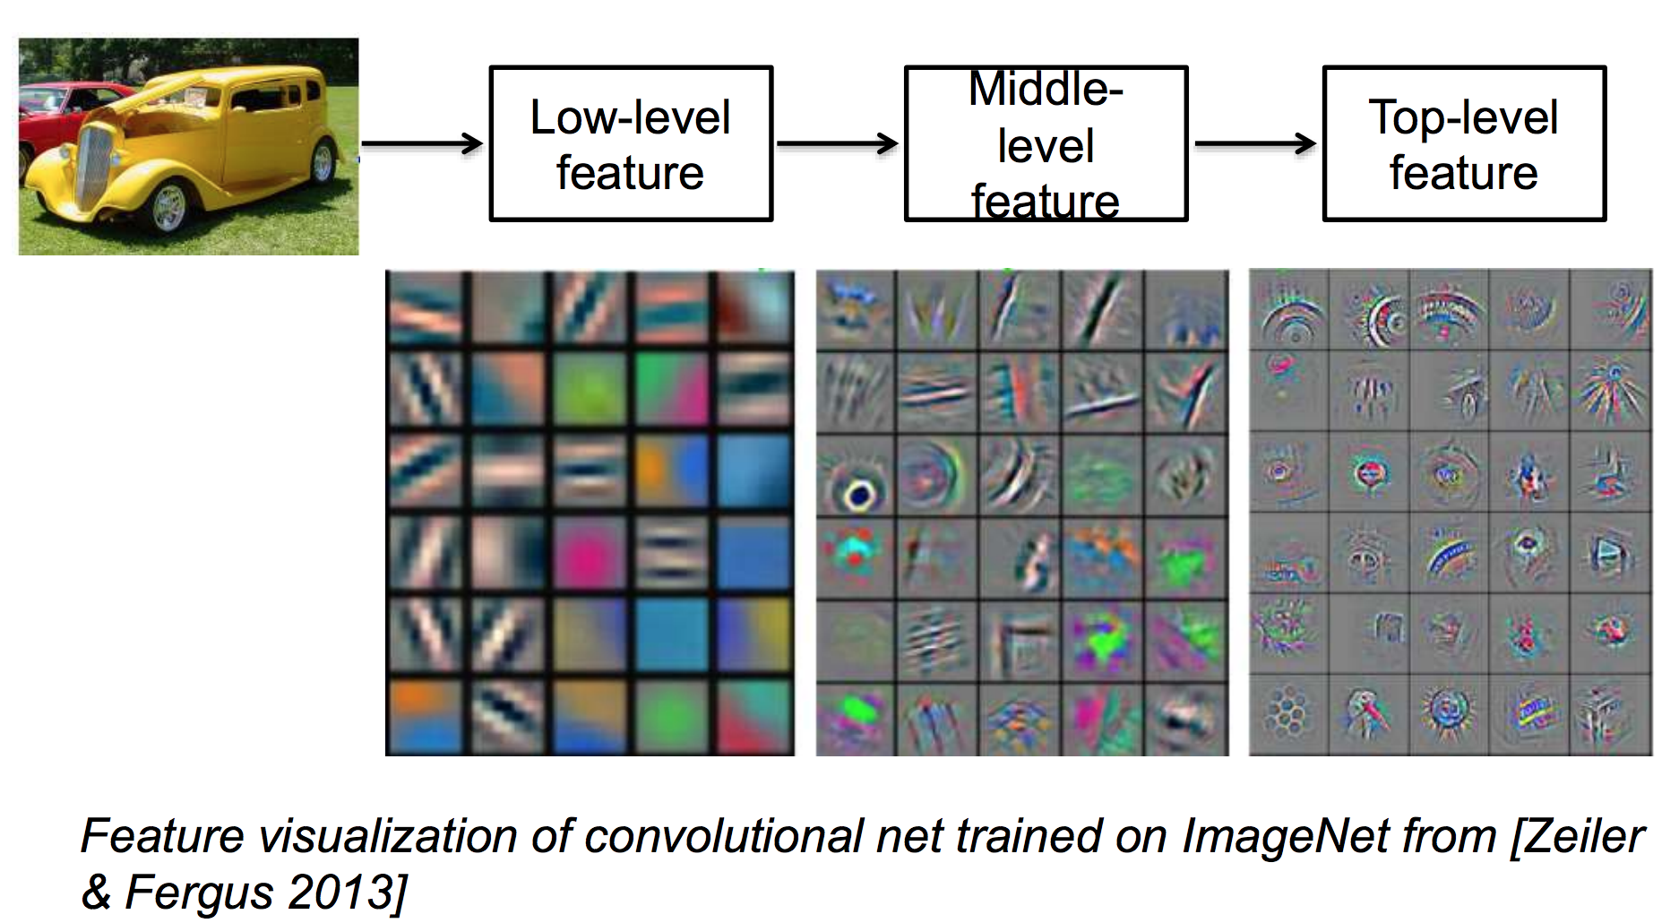
Learning feature representations

Slide 4
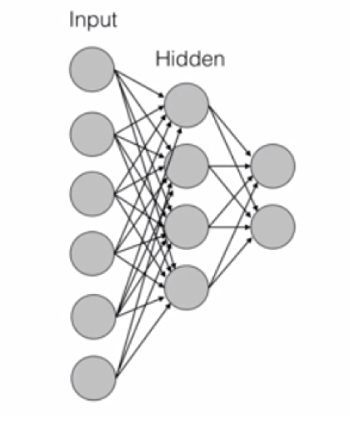
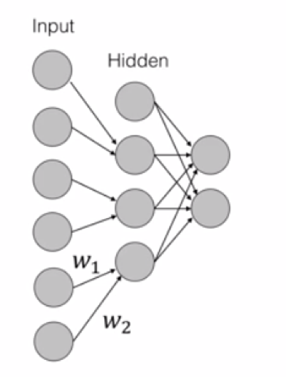
Why convolution

Slide 5
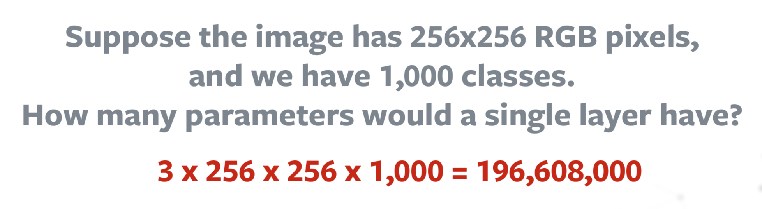
Why convolution
Too many parameters, unscalable to real images

Slide 6
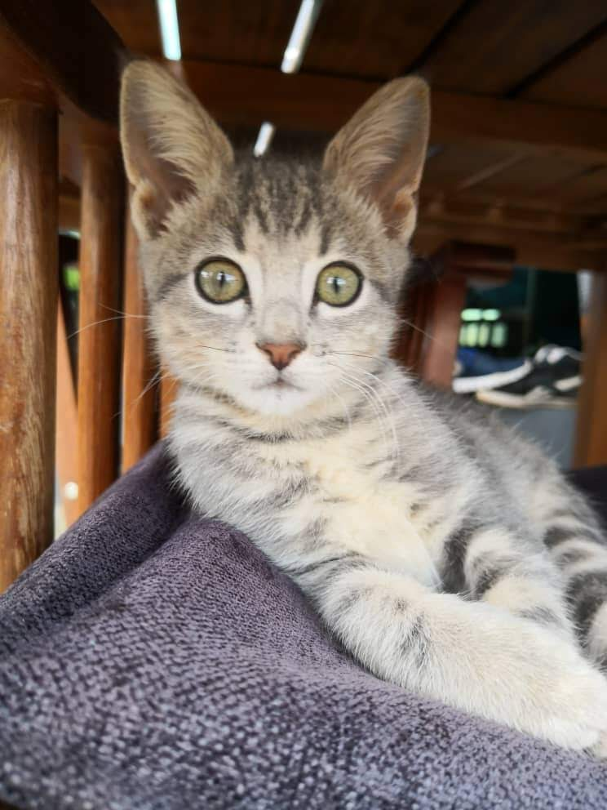
Spatial features
VS

Slide 7
Why convolution
A two-dimensional
array of pixels
CNN
X or O

Slide 8
Why convolution
CNN
X
CNN
O

Slide 9
Trickier cases
CNN
X
translation
scaling
rotation
weight
CNN
O

Slide 10
Deciding is hard ?
?
=

Slide 11
Computers are literals
?
=

Slide 12
What computer see

Slide 13
Computers are literals
=
x

Slide 14
Our target is to match image pieces!
=
=
=

Slide 15
Concept of features

Slide 16
Concept of features

Slide 17
Filtering: The math behind the match
Line up the feature and the image patch.
Multiply each image pixel by the corresponding feature pixel.
Add them up.
Divide by the total number of pixels in the feature.

Slide 18
Convolution process
1 x 1 = 1

Slide 19
Convolution process
1 x 1 = 1

Slide 20
Convolution process
-1 x -1 = 1

Slide 21

Convolution process
$$\frac{1+1+1+1+1+1+1+1+1}{9}=1$$

Slide 22

Convolution process
$$\frac{1+1−1+1+1+1−1+1+1}{9}=.55$$
.55

Slide 23
Convolution process
=
Demo 0

Slide 24
Multi-features
=
=
=

Slide 25
Convolution layer
One image becomes a stack of filtered images

Slide 26
Outline
Why Deep Learning ?
1
Why Convolution ?
2
Convolutional Networks
3
Applications
4
Popular architectures
5
Demo
6

Slide 27
Q: So How we learn these filters using NN ?

Slide 28
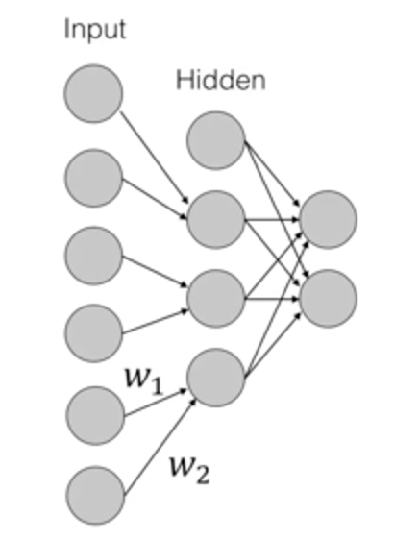
Filter weights -→ NN weights

Slide 29
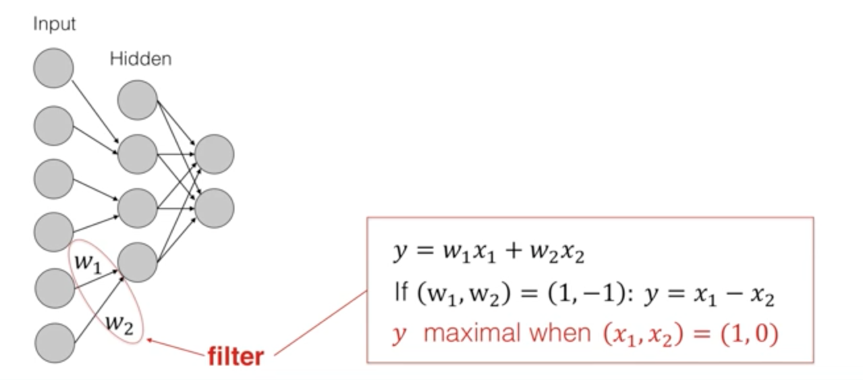
Filter weights -→ NN weights

Slide 30
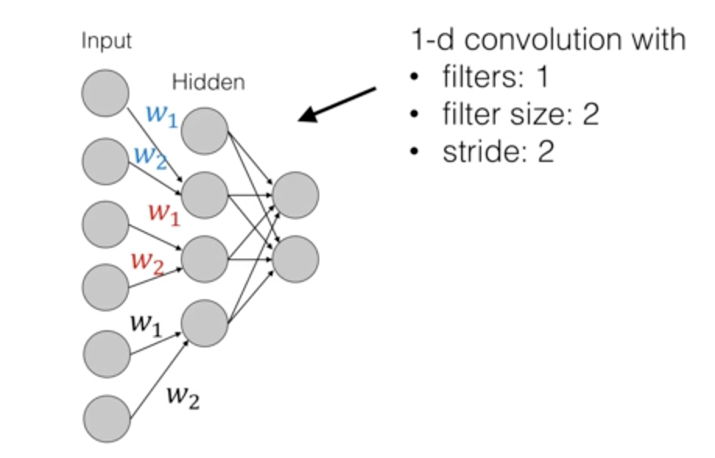
Filter weights -→ NN weights

Slide 31
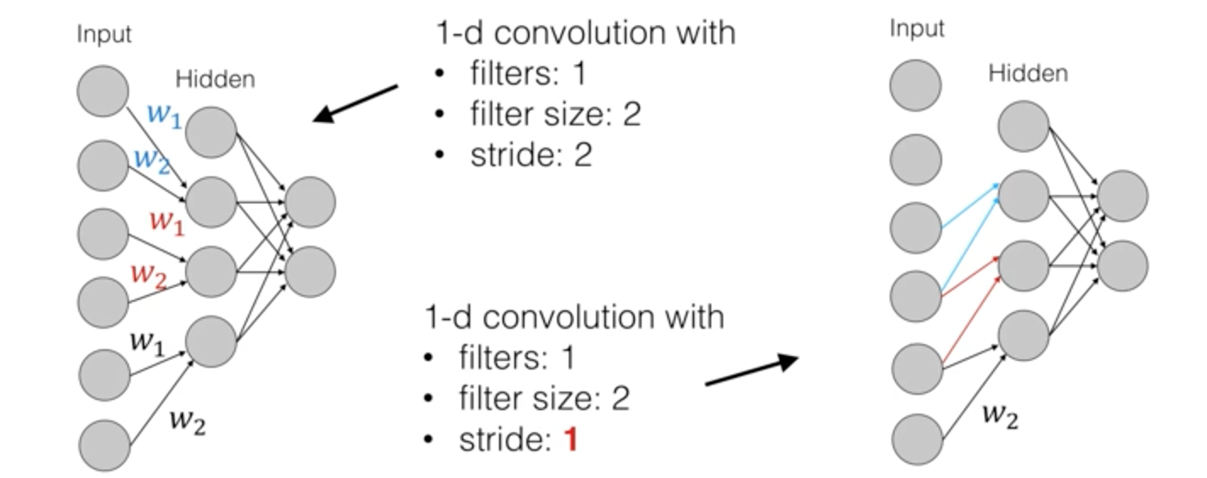
Filter weights -→ NN weights

Slide 32
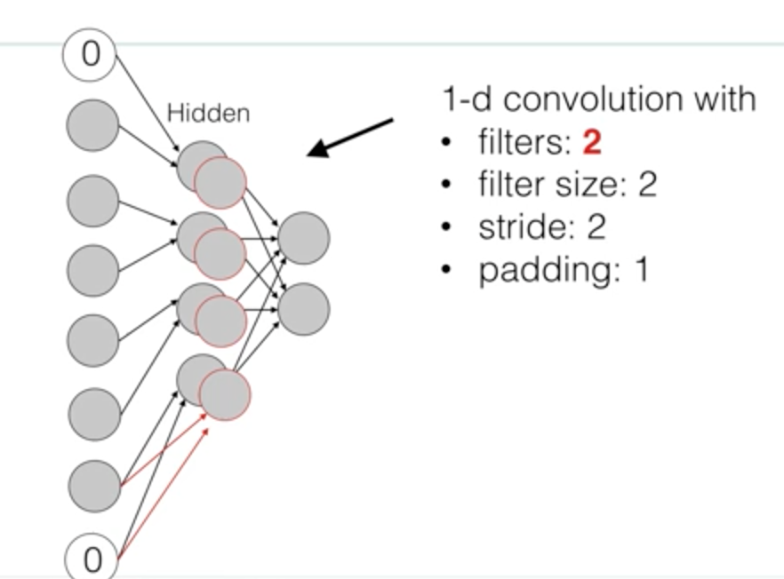
Filter weights -→ NN weights

Slide 33
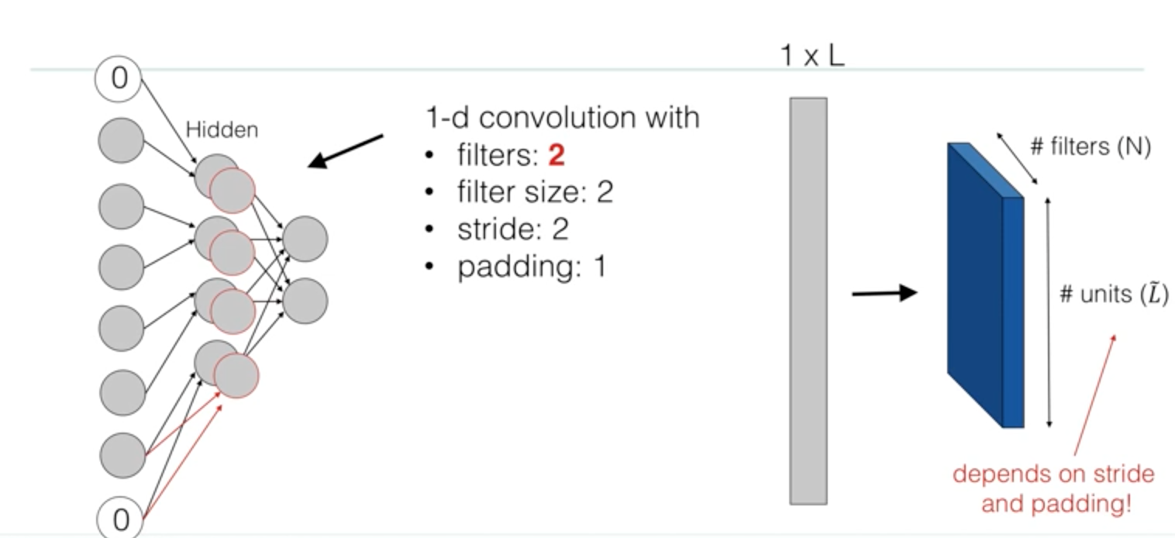
1-D convolution

Slide 34
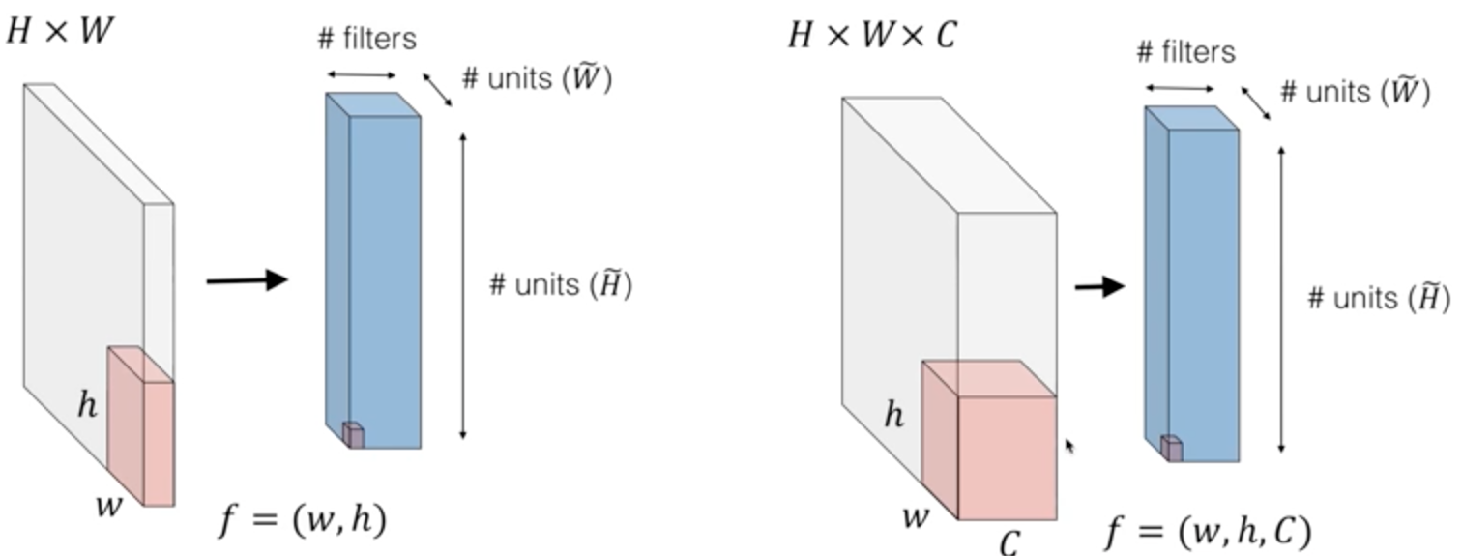
2-D convolution

Slide 35
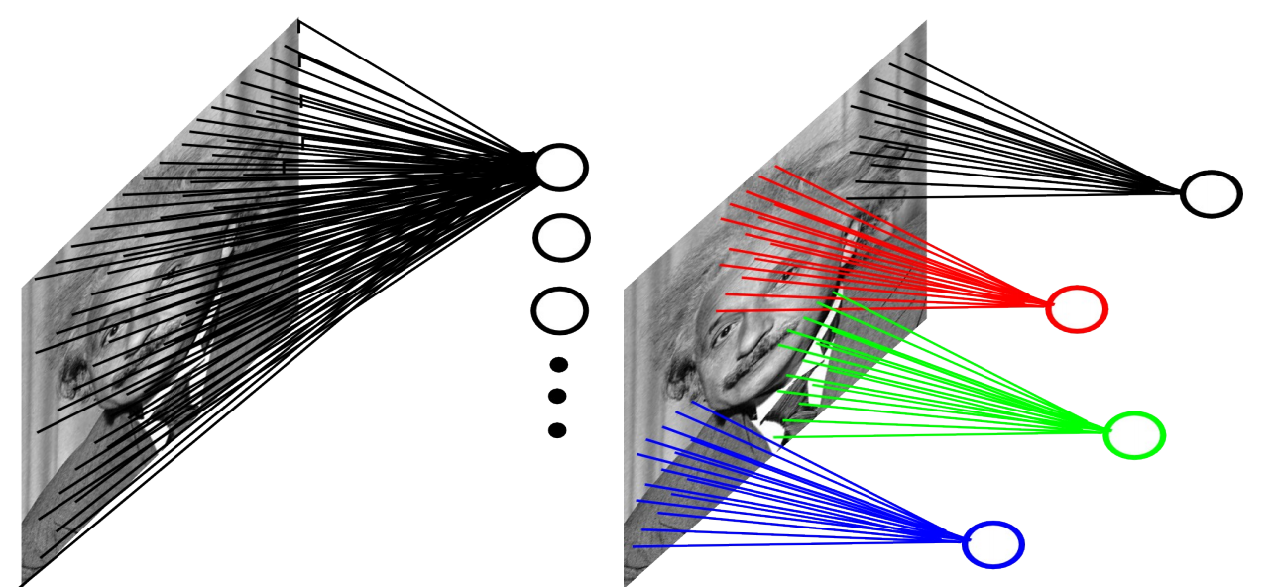

Slide 36
Pooling
Pick a window size (usually 2 or 3).
Pick a stride (usually 2).
Walk your window across your filtered images.
From each window, take the maximum value.

Slide 37
Pooling
maximum

Slide 38
Pooling
maximum

Slide 39
Pooling
maximum

Slide 40
Pooling
maximum

Slide 41
Pooling
max pooling

Slide 42
Pooling

Slide 43
Pooling
A stack of images becomes a stack of smaller images.

Slide 44
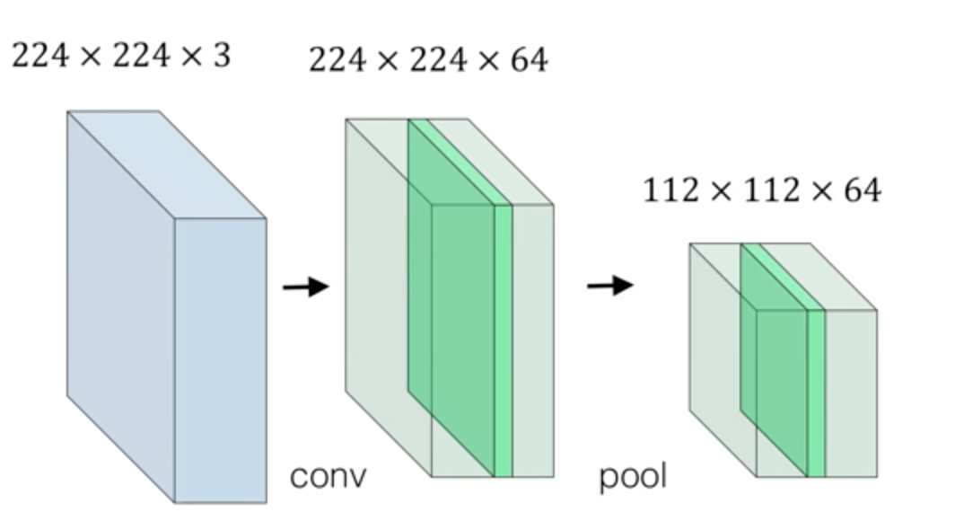
Pooling (sub-sampling)

Slide 45
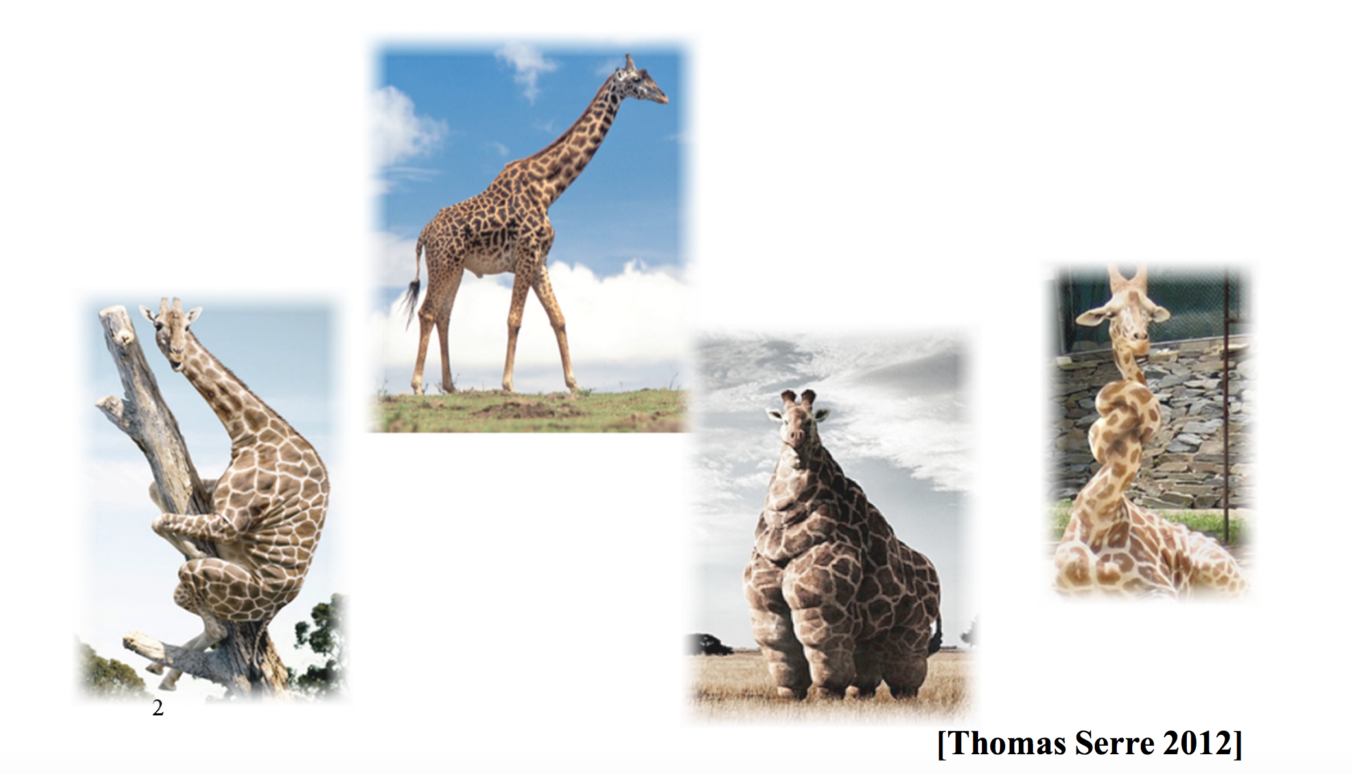
Pooling – invariance

Slide 46
Normalization

Slide 47
Normalization

Slide 48
Normalization

Slide 49
Normalization

Slide 50
Normalization

Slide 51
Relu VS Sigmod
Relu: Reduce the likelihood of the gradient to vanish
Sigmoid: tend to vanish gradient
Relu : tend to blow up activation (a is the output itself)
Relu: More computationally efficient to compute than Sigmoid
Relu : Dying Relu problem
Demo 1
Demo 2

Slide 52
Layers get stacked
Convolution
ReLU
Pooling

Slide 53
Layers get deep stacked
Convolution
ReLU
Convolution
ReLU
Pooling
Convolution
ReLU
Pooling

Slide 54
Learned features How to classify ?

Slide 55
Fully connected layer

Slide 56
Fully connected layer
X
O

Slide 57
Fully connected layer
X
O

Slide 58
Fully connected layer
X
.92
O
.51

Slide 59
Fully connected layer
X
O

Slide 60
Fully connected layer
X
O

Slide 61
Fully connected layer
X
O

Slide 62
Putting it all together
.92
X
Convolution
ReLU
Fully
connected
Fully
connected
Convolution
ReLU
Convolution
ReLU
Pooling
Pooling
O
.51

Slide 63
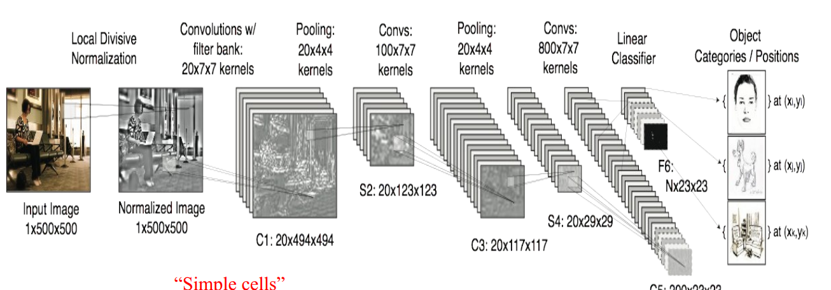
Putting it all together

Slide 64
Putting it all together
.92
X
Convolution
ReLU
Fully
connected
Fully
connected
Convolution
ReLU
Convolution
ReLU
Pooling
Pooling
O
.51
Demo 3

Slide 65
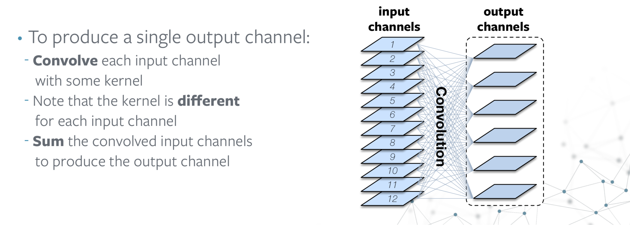

Slide 66
Hyperparameters ?
Convolution
Number of features
Size of features
Pooling
Window size
Window stride
Fully Connected
Number of neurons
Architecture
How many of each type of layer?
In what order?
nonlinear transformations

Slide 67
Outline
Why Deep Learning ?
1
Why Convolution ?
2
Convolutional Networks
3
Applications
4
Popular architectures
5
Demo
6

Slide 68
Not just images
Any 2D (or 3D) data
Spatial features

Slide 69
Images
Columns of pixels
Rows of pixels

Slide 70
Sound
Time steps
Intensity in each
frequency band

Slide 71
Text
Position in
sentence
Words in
dictionary

Slide 72
Spatial features become limitations themselves
How ?

Slide 73
Name, age,
address, email,
purchases,
browsing activity,…
Example
Customers

Slide 74
Rule of thumb
If your data is just as useful after swapping any of your columns with each other, then you can’t use Convolutional Neural Networks.

Slide 75
Outline
Why Deep Learning ?
1
Why Convolution ?
2
Convolutional Networks
3
Applications
4
Putting it all together
5
Demo
6

Slide 76
References
[1] | Brandon Roherer, Deep CNN for Image Classification
[2] | I. S. G. E. H. Alex Krizhevsky, "ImageNet Classification with Deep Convolutional Neural Networks," NIPS, 2012.
[3] | ImageNet, "ILSVRC results," 2016. [Online]. Available: http://www.image-net.org/challenges/LSVRC/.
[4] | L. D. a. D. Yu, Deep Learning Methods and Applications, 2013.
[5] | G. I. Quo c V. Le Go ogle Brain, "A Tutorial on Deep Learning,Part 1: Nonlinear Classifiers and The Backpropagation Algorithm," December 2015.
[6] | Y. LeCun, "Gradient-Based Learning Applied to document recognition".
[7] | J. Schmidhuber, "Deep learning in neural networks: An overview," 12 September.
[8] | B. Y. Bengio, "Learning Deep Architectures for AI".
[9] | R. F. (NYU), "Deep Learning Methods for Vision CVPR 2012".
[10] | S.-Y. L. Hyun Ah Song, Hierarchical Representation Using NMF.
[11] | C. Szegedy, "Going deeper with convolutions," 2014.
[12] | Dr.karpathy, "CS231n Convolutional Neural Networks for Visual Recognition," 26 11 2016. [Online].
[13] | D. o. C. S. C. I. N. Y. U. Matthew D. Zeiler, "Visualizing and Understanding Convolutional Networks," 2013.
[14] | V. N. a. G. Hinton, "Rectified Linear Units improve Restricted Boltzmann Machines," International Conference on Machine Learning, 2010.

Slide 77
Summary
Deep Learning for learning features representations
Convolutional features are trained to match spatial features
Very flexible models, many hyper parameters challenge
many trade-offs
performance (memory and time)
Accuracy
Depth
Better yet simpler feature representations

